Slide 1
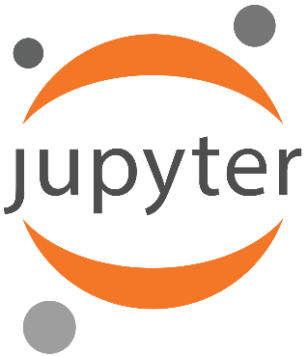

Using Jupyter notebooks containing PowerShell for interactive/live documentation

Slide 2


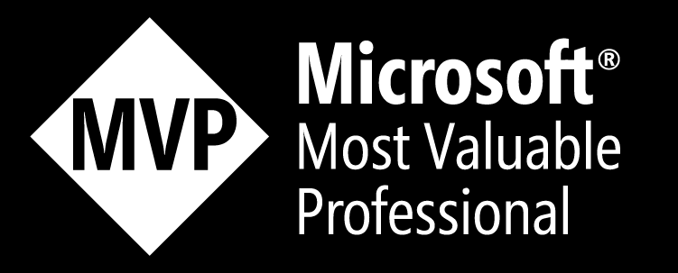
Harm
Veenstra
(Pre-Sales) Microsoft Consultant at NEXXT
Lives in Steenwijk, likes gaming🎮, tech ⚙️, and house music 🎶
Microsoft MVP PowerShell since 2024

Slide 3

What are we going to discuss?
1. Why this session?
2. What is Jupyter?
3. What are Polyglot Notebooks?
4. VSCode configuration
5. Two example notebooks
6. Limitations
7. Links

Slide 4
1. Why this session?
Creating documentation isn’t fun; this might help 😊
Reading documentation and executing code in the same view is easier✅
Jupyter notebooks are easy to create and share✅
People don’t know that this exists🤔

Slide 5
2. What is Jupyter?
Jupyter Notebooks are a spin-off project from the IPython project, which
used to have an IPython Notebook project. Jupyter comes from the core
supported programming languages it supports: Julia, Python, and R. Jupyter
ships with the IPython kernel, allowing you to write your programs in Python.
Still, there are currently over 100 other kernels that you can also use.😲
I created a Blog Post about Jupyter in August 2022. Things are easier nowadays,
this will be explained in the following slides.😮‍💨

Slide 6
3. What are Polyglot notebooks?
With Polyglot Notebooks, not only can you use multiple languages natively within the same notebook with full language server support, but you can also share variables between them to maintain a continuous workflow. No need to bounce around from tool to tool and manually transfer data between tools to continue your work.
The Polyglot Notebooks extension in VS Code currently supports the following languages, with more to come:
C#, F#, PowerShell, JavaScript, HTML*, Mermaid*, SQL, KQL (Kusto Query Language)
*Variable sharing not available

Slide 7
4. VSCode Configuration
Install Visual Studio Code 😉
Install the Microsoft .NET SDK v9.0➕
Install the “Polyglot Notebooks” extension➕
Create, or open an existing, .ipynb notebook. 📂
(ipynb = iPythonNoteBook, the project that started this all)
Wait for the .NET Interactive engine to install (It will prompt for
installation if needed)⌚
Start writing 😎

Slide 8
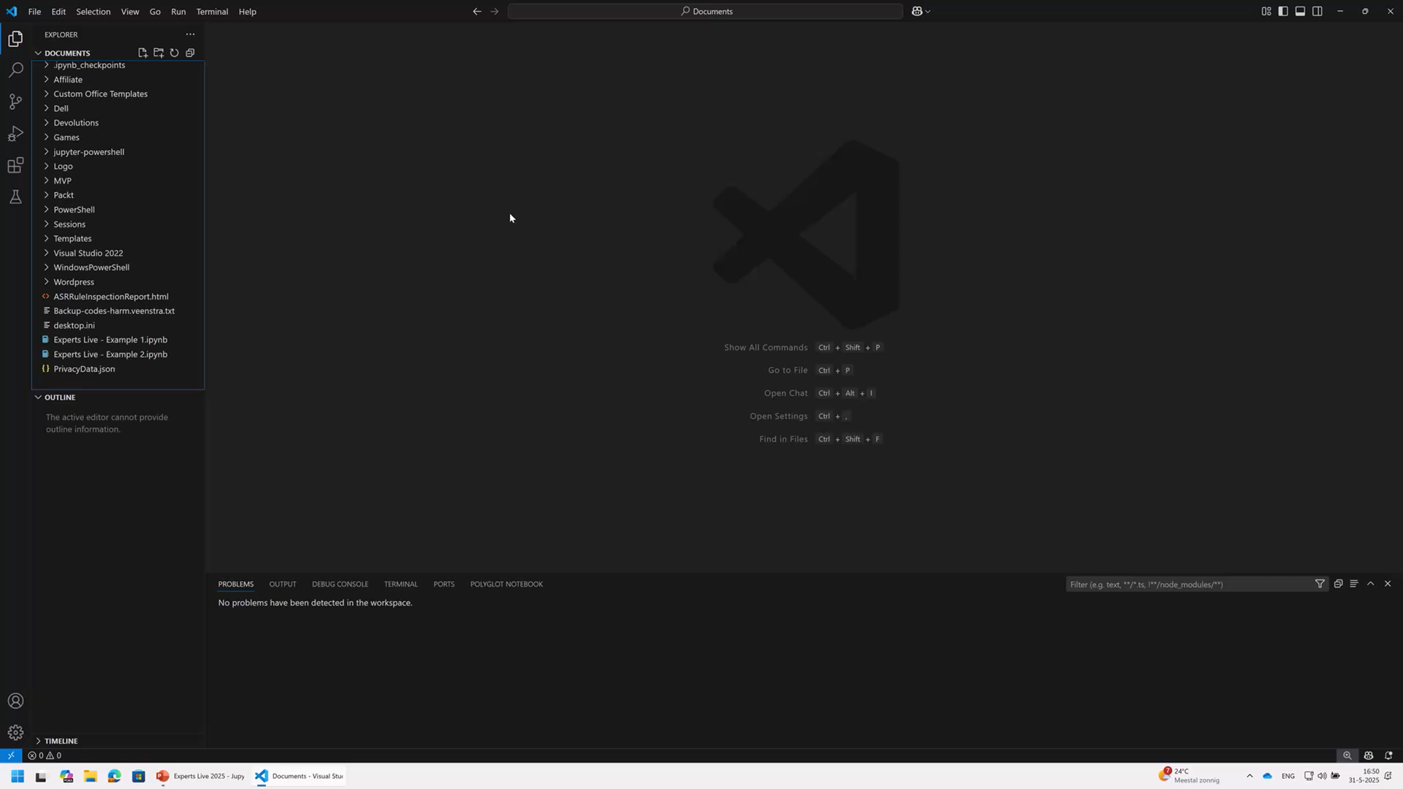

Slide 9
5. Example notebooks
Example 1: Update Send As Permissions📩
Example 2: Reset MFA for a specific user🔐

Slide 10
6. Limitations
Output can’t be displayed in an Out-GridView window or Out-ConsoleGridView
pane, scripts that use this to select items will fail❌
The PowerShell version is 1.0.0 because it runs inside the .NET Interactive Host.
As a result, it may not be compatible with all modules or scripts that have
version checks within them. (Note: It seems to be PowerShell v7 because the
pwsh kernel is used)⁉️
Modern Authentication screens will not pop up; you need Device or
Certificate-based login for anything Entra/365❌

Slide 11
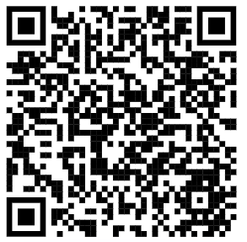
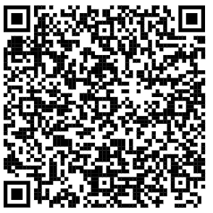
7. Links
More information on Polyglot notebooks:📓
My initial Blog Post about Jupyter in 2022.
The method still works, but not as easily as the
Polyglot extension in VSCode😮‍💨

Slide 12

Please evaluate this session in the App.
THANK YOU
Are there any questions?

